Slide 1

Unsigned Fixed-point Multiplier-Accumulator Design
By: Marwan Abbas

Slide 2
Introduction
Multiply-Accumulate (MAC) Unit
Fixed-Point

Slide 3
Multiply-accumulate (MAC) unit
Consists of two operations
Multiplication
Accumulation/Addition
Used with Digital Signal Processing (DSP)
Used with neural network training and inference

Slide 4

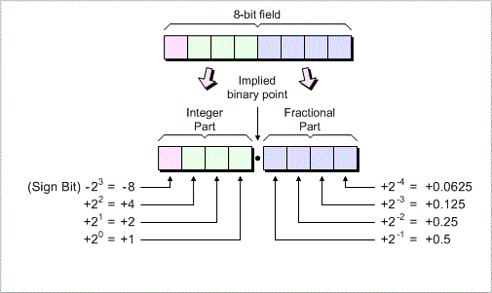
Fixed-point
8-bits, 4 for integer part and 4 for fraction part
How to convert from binary to decimal fixed-point

Slide 5
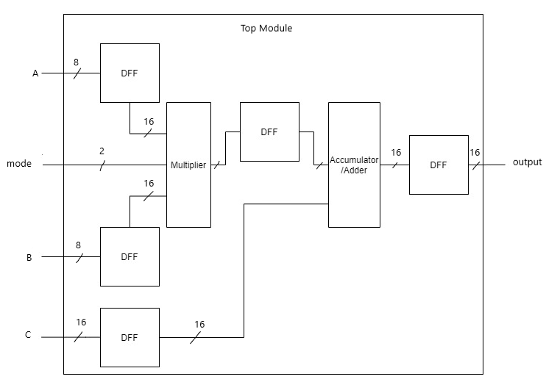
Architecture
Three functions that this architecture can handle:
8 bits * 8 bits + 16 bits
4 bits * 4 bits + 16 bits
2 bits * 2 bits + 16 bits

Slide 6
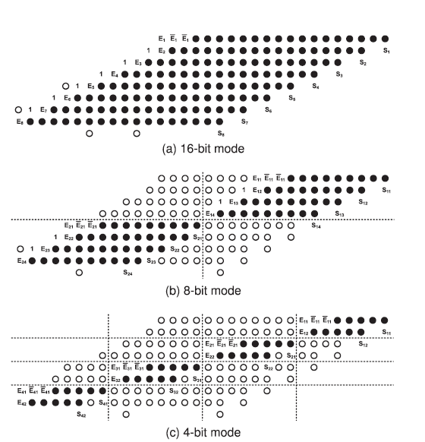
Multiplier
Multiply A * B
Mode bit used to choose the mode for the multiplier
Mode 00: 8-bit mode
Mode 01: 4-bit mode
Mode 10: 2-bit mode
Divides the input with regards to the mode
Sums up the partial products
H. Zhang, D. Chen, and S. B. Ko, “New Flexible Multiple-Precision Multiply-Accumulate Unit for Deep Neural Network Training and Inference,” IEEE Trans. Comput., vol. 69, no. 1, pp. 26–38, 2020, doi: 10.1109/TC.2019.2936192.

Slide 7
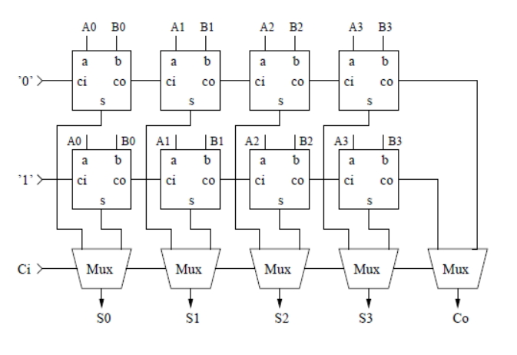

Accumulator/adder
O(n−−√n) delay
O(n−−√n) delay
16 bits Carry Select Adder (CSA)
Faster than normal adder
Uses Full Adders (FA) and Multiplexers (MUX)
O($\sqrt{n}$) delay

Slide 8
D Flip-Flop (DFF)
Used to make the architecture pipelined
Stores:
Input
Product of the multiplier
Output of the system

Slide 9
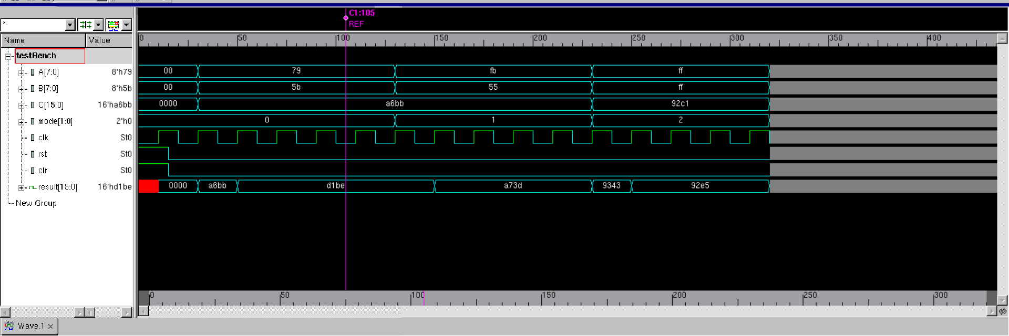
Testing
Behavioral test bench
Verilog doesn’t accept fixed point representation
Integers fed into the input
Example:
111.1001 7.5625
x x
101.1011 6.6875
+ +
10100110.10111011 166.7304688
------------------------------- ----------------------------
11010001.10111110 209.7421875

Slide 10
Results/Findings
Timing:
0.80 ns
Area:
894.82 µm²
Total Power:
150.53 µW

Slide 11
THANK you!

